Slide 1
Introduction to Database Management Systems
Instructor: Li Wang

Slide 2
Questionnaire

Slide 3
Syllabus

Slide 4
DBMS Introduction
Use of DBs
Sample DB
Brief History
Most Common Current DBMS Implementations

Slide 5
Why Do I Care About DBs
99% of my projects at work include a DB
how many school projects?

Slide 6
Uses of Databases
Used in large and small organizations. Examples
Consumer websites and customer service websites
Online banking
Credit card companies
Supermarkets and retail stores
Airline reservations
Medical records and billing
Employment records
School records
Bibliographic Databases
Advanced applications-Geographic Information Systems, software development, scientific research, Decision Support Systems, Customer Relations Management, search engines

Slide 7
A Sample Database
Simple University database
Keeps information about
Students
Classes-links Faculty to their classes
Enrollment-links students to their classes
Data represented as tables
Each row of Student table represents one student, of Faculty one faculty member, of Class one class
Each row of Enroll represents relationship between one student and one class

Slide 8
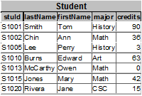
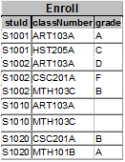
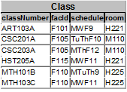

Slide 9
The Integrated Database Environment
Database
Large repository of data
Shared resource, used by many departments and applications of an enterprise
Contains metadata -“knows” about structure and relationships in data
Managed by database administrator - DBA
DBMS, Database Management System
Controls access to database: window service
Has facilities to
Set up database structure
Load the data
Retrieve requested data and format it for users
Hide sensitive data
Accept and perform updates
Handle concurrency
Perform backup and recovery … and many other functions…
Users
Applications

Slide 10
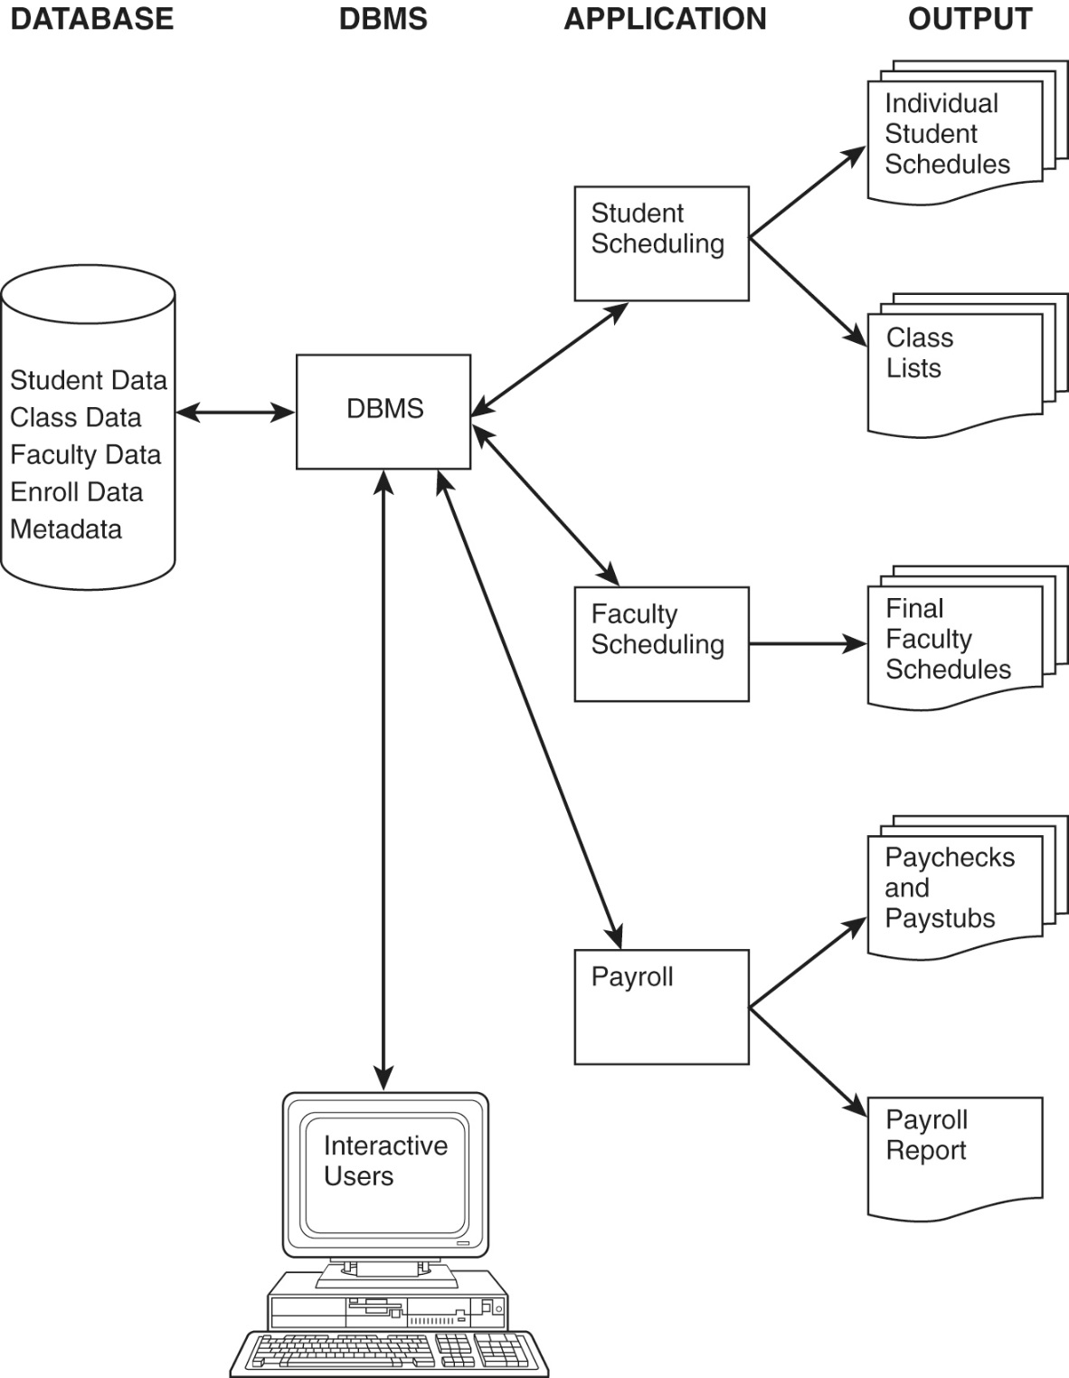

Slide 11
Example of Integrated Database Environment
University database
DBMS - may be SQL Server, Oracle, DB2,…
Users may be individuals on workstations (interactive users) or application programs
Both users and applications go through DBMS
Applications produce standard output, such as reports

Slide 12
Advantages of Integrated Databases
Compared with file systems, which create “islands of information”, database can provide
Sharing of data throughout the enterprise
Control of redundancy
Data consistency
Improved data standards
Better data security
Improved data integrity
Balancing of conflicting requirements
Faster development of new applications
Better data accessibility
Economy of scale
More control of concurrency
Better backup and recovery procedures

Slide 13
Brief History of Information Systems
Sequential Access
punch cards/tape
magnetic tape
Direct Access
Magnetic disk introduced in 1950s
Programming languages COBOL and PL/1 developed in 1960s
Early database models developed
Hierarchical model
IBM IMS developed for Apollo moon landing project
Most popular pre-relational DBMS
Network model
Standards published in 1973, 1978, 1981 and 1984
Provided standard terminology, notion of layered database architecture

Slide 14
Brief History of Information Systems
Relational model
Proposed by E.F. Codd in 1970 paper, "A Relational Model of Data for Large Shared Data Banks"
Strong theoretical foundation
System R, late 1970s
IBM’s prototype relational system
Introduced SQL (Structured Query Language), now standard language
Peterlee Relational Test Vehicle, IBM UK Scientific Laboratory
INGRES, University of California, Berkeley
Larry Ellison’s ORACLE used some System R results
Early microcomputer relational DBMSs :dBase, R:Base, Foxpro, Paradox
Microsoft Access, Oracle, DB2, Informix, Sybase, MySQL, PostGreSQL, Microsoft’s SQL Server most popular DBMSs

Slide 15
Brief History of Information Systems
Entity Relationship model - P.P. Chen, 1976
Semantic model – tries to capture meaning, used mostly for design
Object-oriented model - Introduced in 1990s
Can handle complex data
UML used for modeling
Object-oriented programming languages extended
Data warehouses - developed in 1990s
Take data from many sources
May store historical data
Used for data mining, finding trends in data
Distributed Databases – Block Chain

Slide 16
DBs Today
relational / OO models
using SQL (Structured Query Language)
using DBMS (Database Management System)
a software “package”
manages DBs
manages data storage
can run on multiple OS
basic supported features – supports data modeling, query language, access controls, transactions
some support more advanced features – backup, replication, encryption

Slide 17
Most Common RDBMS
Oracle
Oracle
C/C++
OS - multiple
used by large corporations
sells different packages
inline SQL, but also management tools
e.g. Enterprise Edition -> $40 – 80K/processor (2010)
MySQL
MySQL AB (Subsidiary of Oracle)
C/C++
OS – multiple
source code available under GNU General Public License
open source
multiple flavors
used by free/open source projects
also used by Google, Wikipedia
Oracle seems to be cutting back support (change sets, documentation)

Slide 18
Most Common RDBMS cont’ed
SQL Server
Microsoft
C/C++/C#
OS – Windows
used in this class
many options, including SQL CE, Reporting Services
incorporated into Visual Studio and other MS tools
e.g. Enterprise Edition -> $20K/processor (2010)

Slide 19
Relational DB – Codd’s Rules
basis for a relational model, which lead to the development of RDBMS
The rules are:
DBMS must be able to manage DB via relational capabilities
All information is represented in a tabular format
Guaranteed Access – every value is guaranteed to be accessible by a combination of the table name, the primary key and the column name
Null value support – DBMS supports null value, which is distinct from default values and independent of any domain
Active, online relational catalogue – description of the DB and its contents is represented in a tabular format, and can be queried

Slide 20
Relational DB – Codd’s Rules cont’d
Comprehensive data sublanguage – languages must have a well-defined syntax; supports data definition, manipulation, integrity rules, authorization and transactions
View updating – all views that are theoretically updatable, can be updated
Set-level insertion, updating and deletion – DBMS supports retrieval of sets as well as insertion, updating and deletion
Physical data independence – application programs are unaffected when physical access methods change

Slide 21
Relational DB – Codd’s Rules cont’d
Logical data independence – application programs are logically unaffected when changes are made to table structures
Integrity independence – DB language must be capable of defining integrity rules. These will be stored in the online catalogue and cannot be bypassed.
Distribution independence – application programs are logically unaffected when data is first distributed (or redistributed).
Nonsubversion – it must be impossible to bypass the integrity rules by using lower level languages.

Slide 22
Data Models

Slide 23
Relational Model
Record-based model
Logical-level model
Based on mathematical relations
Tables represent relationships as well as entities
Columns of tables represent attributes

Slide 24
Object-oriented Model
includes encapsulation, inheritance
Objects have both state and behavior
State is defined by attributes (table column, field)
Behavior is defined by methods (functions or procedures)
Designer defines classes with attributes, methods, and relationships
Class constructor method creates object instances
Each object has a unique object ID
Classes grouped into class hierarchies
Database objects have persistence
Both conceptual-level and logical-level model
UML class diagrams often used

Slide 25
Semi-structured Model
Collection of nodes, each with data, with different schemas
Node contains a description of its own contents
Can be used for integrating existing databases
XML tags in documents describe structure
XML tags identify elements, sub-elements, attributes in documents
XML DTD (Document Type Definition) or XML Schema used to define structure

